Slide 1
Motion Controller
Training
Trainer: Shrikant Takale & K.Pradeep
By
Nanjayan N R
Nivin Clinton A

Slide 2
Contents of Motion CPU:
Overview of Q17nD Motion Controllers
Specifications
System Configuration and Components
Mounting Specification for CPU and Motion Modules
Q17nD Motion Hardware

Slide 3
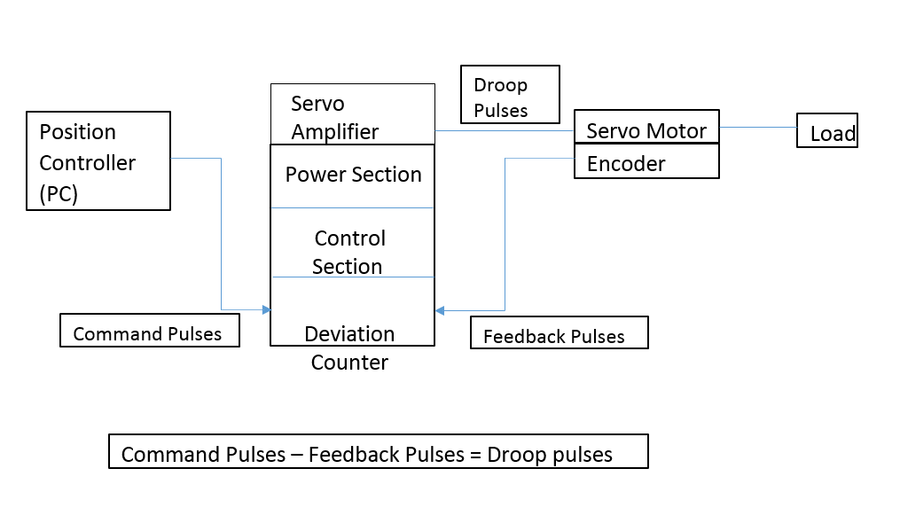
Block Diagram of Servo Amplifier:

Slide 4
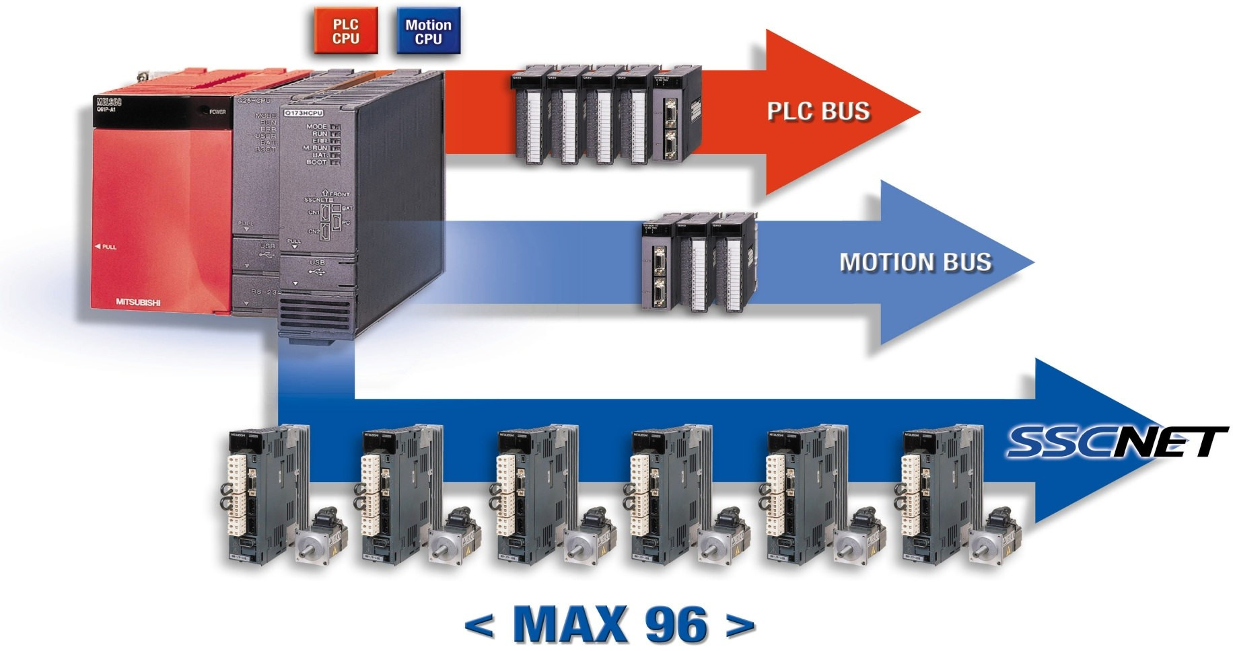
Overview:

Slide 5
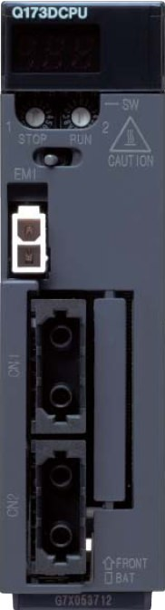
Overview:
Two motion CPUs : Q172DCPU & Q173DCPU
Q172D CPU : 8 axes control
Q173D CPU : 32 axes control
Maximum Three Motion C P U along with O ne Sequence CPU
This can control 96 axes if all three are Q173DCPU!
SSCNET− I I I based system
The SSCNET III (Servo System Controller NETwork) is an optical High−Speed Network for data transmission with up to 50 Mbit/s
Works with M R−J 3 −B type servo amplifiers

Slide 6
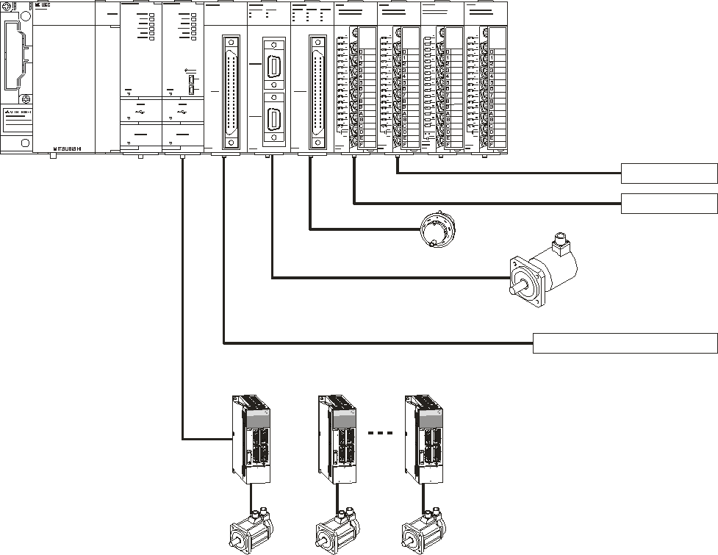
System Configuration:
QnU CPU
Power supply
These module are assigned to Motion-CPU.
These module are assigned to Q-CPU.
Inputs / Outputs
Main Rack
Interrupt-Inputs
Motion-CPU
MPG
Absolute-Encoder (Q170ENC)
SSCNET III
external servo signals
up to 32 servo amplifier (MR-J3-B)
Servo motors

Slide 7
System Configuration:
Always a Q CPU has to be used in combination with a Motion C P U
Q03UDCPU or high performance C P U can be used
The first C P U on a main unit must be a Q−C P U
Additional C P U s can be placed on the main unit in any order
QD−Motion−System modules Q172DEX, Q172DLX and Q173DPX can not be mounted in CPU3 and CPU4 (I /O 1 and I /O 2) slots
Motion Module can be accessed by only One Motion C P U
Digital I/O−Modules and Analog modules can be assigned to it
Motion−CPU can have access to up to 256 I / O s
Maximum Four Analog I / O modules with single Motion C P U

Slide 8







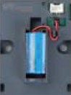
Part Identification of Motion CPU
Rotary Switch for Install Mode
or
Rom Operation
Run/Stop Switch
EMI Input 24V
SSCNET3 Line 1
Q170DBATC (Q6BAT)
SSCNET3 Line 2
only Q173DCPU

Slide 9
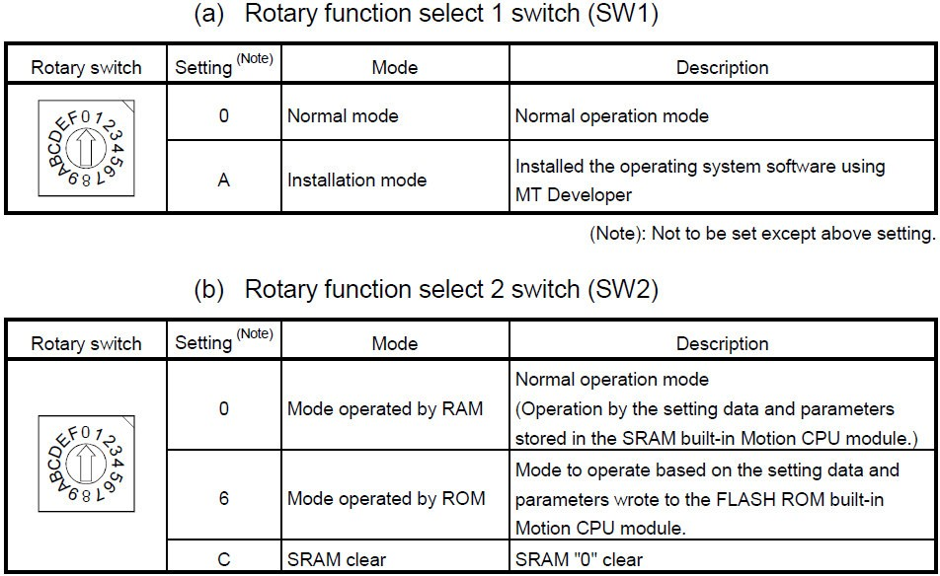
Rotary Switch Setting:

Slide 10
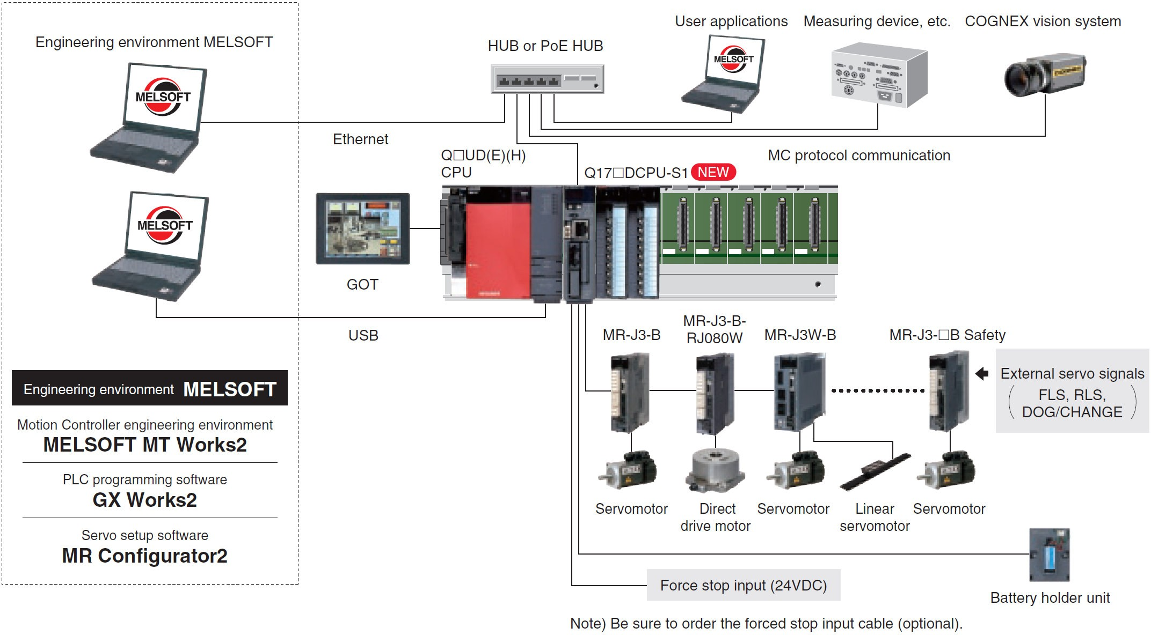
Q172DCPU-S1/Q173DCPU-S1:

Slide 11
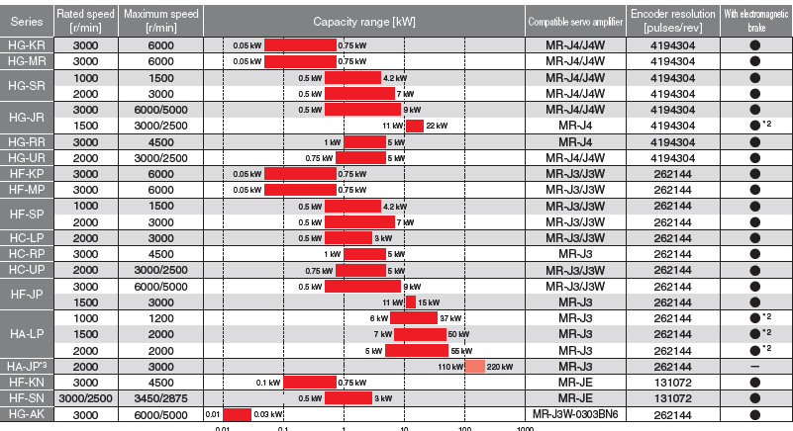
Servo Amplifiers and Motor Types:
CPU Type | Axis | Servo Amplifier Type | Motor Type | Communication
Q172 | 8 axis | MR-JE MR-J2 | HF(0.5kW to 3kW) | SSC Net(speed 5.6Kbps)
Q173 | 32 axis
Q172D | 8 axis | MR-J3 | HA-JP(110kW to 220kW) | SSC Net III(speed 50Mbps)
Q173D | 32 axis | MR-J3 | HA-LP(5kW to 55kW) | SSC Net III(speed 50Mbps)
Q172DS | 16 axis | MR-J4 | HG(0.5kW to 22kW) | SSC Net III/H(speed 150Mbps)
Q173DS | 32 axis

Slide 12
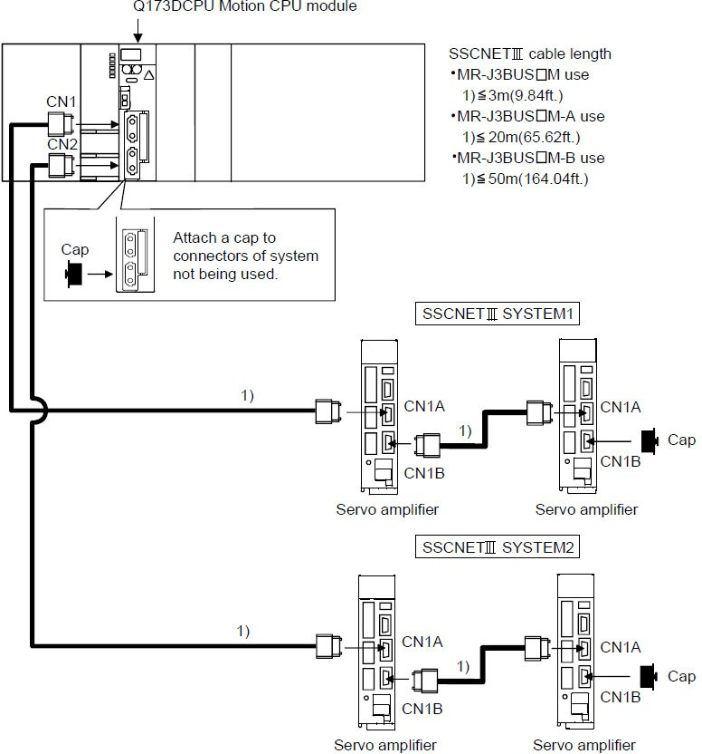
S S C N E T Connection : Q173DCPU

Slide 13
Encoder Types:
1.Incremental Encoder:
It gives A,B and Z pulses.
The number of A/B pulse depends on the resolution. B pulse follows A pulse with phase shift. Z pulse is generated once for every rotation.
It does not have memory to store position and speed values.
The number of output pulses/Revolution depend on the resolution of the encoder.
Example: Some types of encoders are 3600ppr,900ppr,etc.
2.Absolute Encoder:
It has internal registers which can store the position values and speed values.
Unlike incremental this requires battery to store the position values.
For absolute encoder homing should be done during initial commissioning in order to store the reference position.
The resolution is defined in terms of bits/Revolution. For example 5bit encoder has 2^5=32 positions. So 360degree gets divided into 32 parts with each part containing 11 degrees.
2^4 | 2^3 | 2^2 | 2^1 | 2^0 | bits
0 | 0 | 0 | 0 | 1 | 11deg
0 | 1 | 0 | 0 | 1 | 99 deg
Example: Similarly 17bit,18bit and 22bit resolutions are available

Slide 14
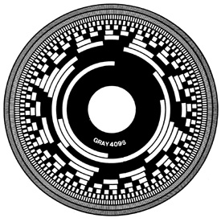
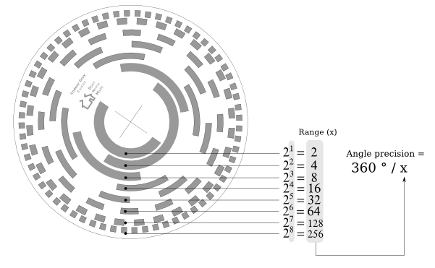
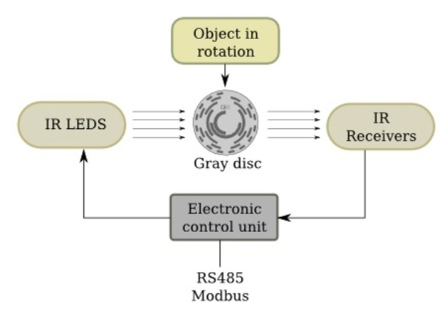
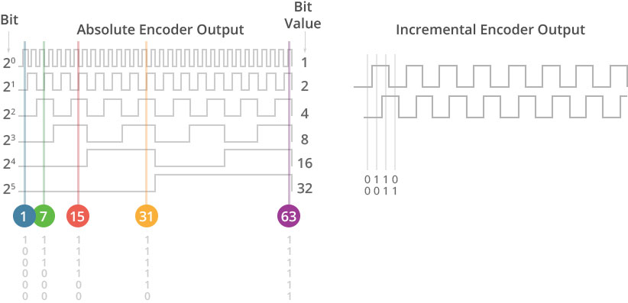
Absolute Encoder Examples:
Typical 12bit Encoder

Slide 15
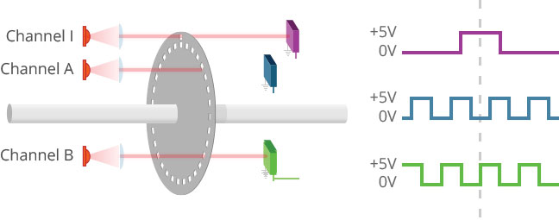
Incremental Encoder Example:

Slide 16
Q&A
Motor Continuous Rotation explain
How encoder values stored in memory during power-off condition
Dual motor connection in single drive
How to terminate SSC-Net communication port in the drive
MPG explain
SERCOS communication Speed
Absolute encoder output and wiring interface with drives

Slide 17
Contents:
Real and Virtual mode
List of the Devices
List of Special Devices
Description of each type of devices
SFC programming

Slide 18
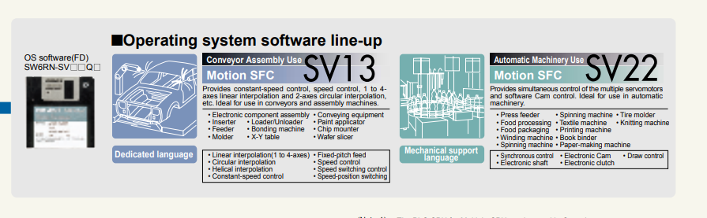
Real and Virtual Mode

Slide 19
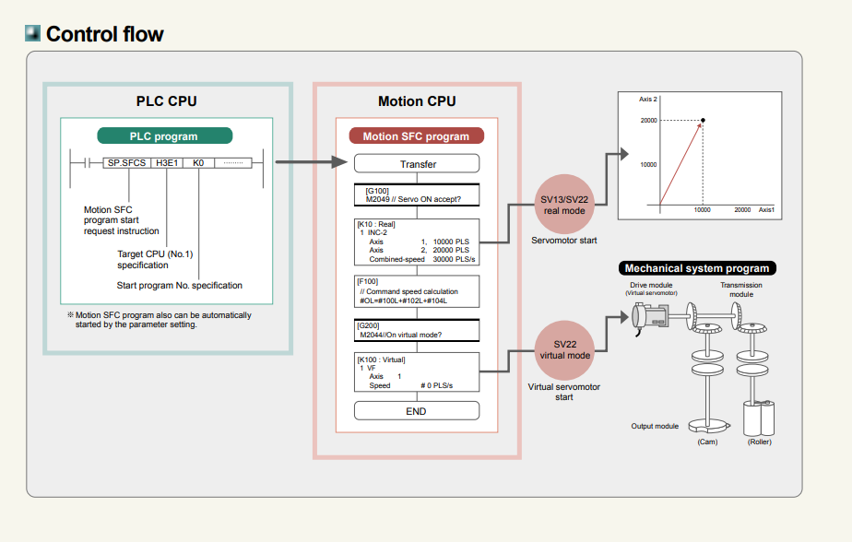

Slide 20
Structure of Motion S F C Program (SV13 / SV22) Real Mode):
system with servomotor is controlled directly using the servo program in (SV13 / SV22) real mode.
S etting of the positioning parameter and creation of the servo program /Motion S F C program are required.
The procedure of positioning control is shown below:
Start S F C program using S F C S instruction or automatically using parameter setting.
Execute the positioning control using the specified the Motion S FC program. (Output to the servo amplifier).
The servomotor is controlled.

Slide 21
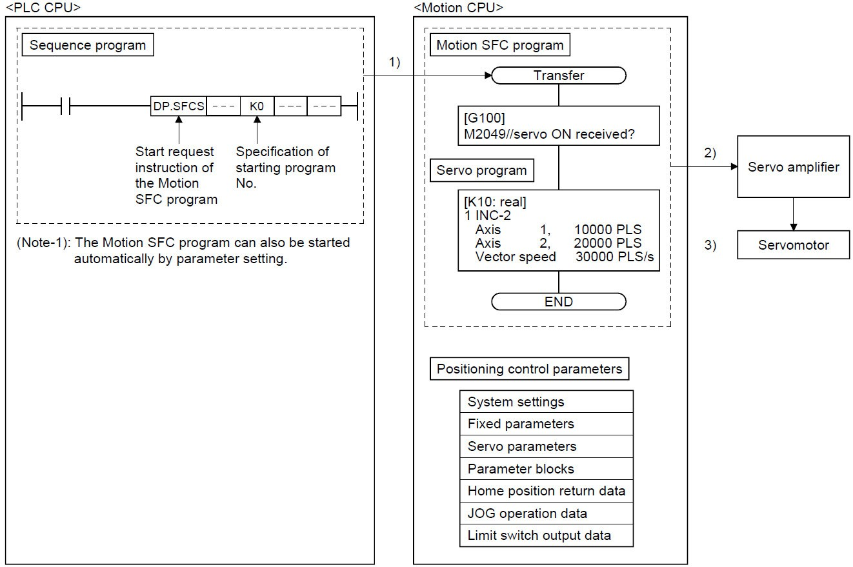
Structure of Motion S F C Program (Real Mode):

Slide 22
Structure of Motion SFC Program (SV22 Virtual Mode):
Software−based synchronous
control is performed
using the
mechanical system editor.
Mechanical system
program is required in addition to the
positioning parameter, servo program/Motion S F C program used in real mode.
The procedure of positioning control in virtual model is shown below:
Start S F C program using S F C S instruction or automatically using parameter setting. (Step 1)
The virtual servomotor in the mechanical system program is started (Step 2)
Output the operation result obtained through the transmission module to the servo amplifier set as the output module. (Step 3)
The servomotor is controlled. (Step 4)

Slide 23
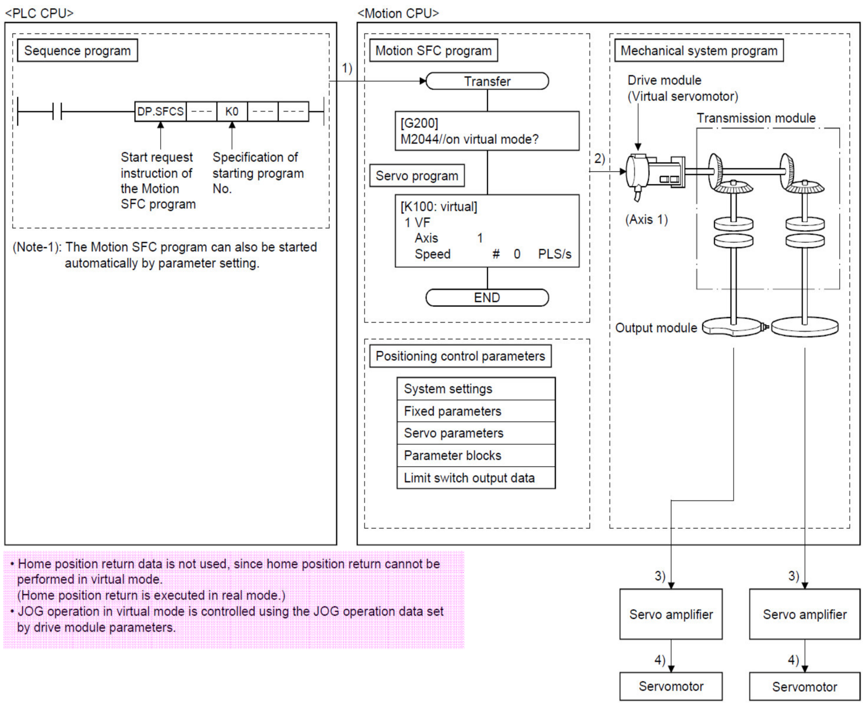
Structure of Motion S F C Program (Virtual Mode):

Slide 24
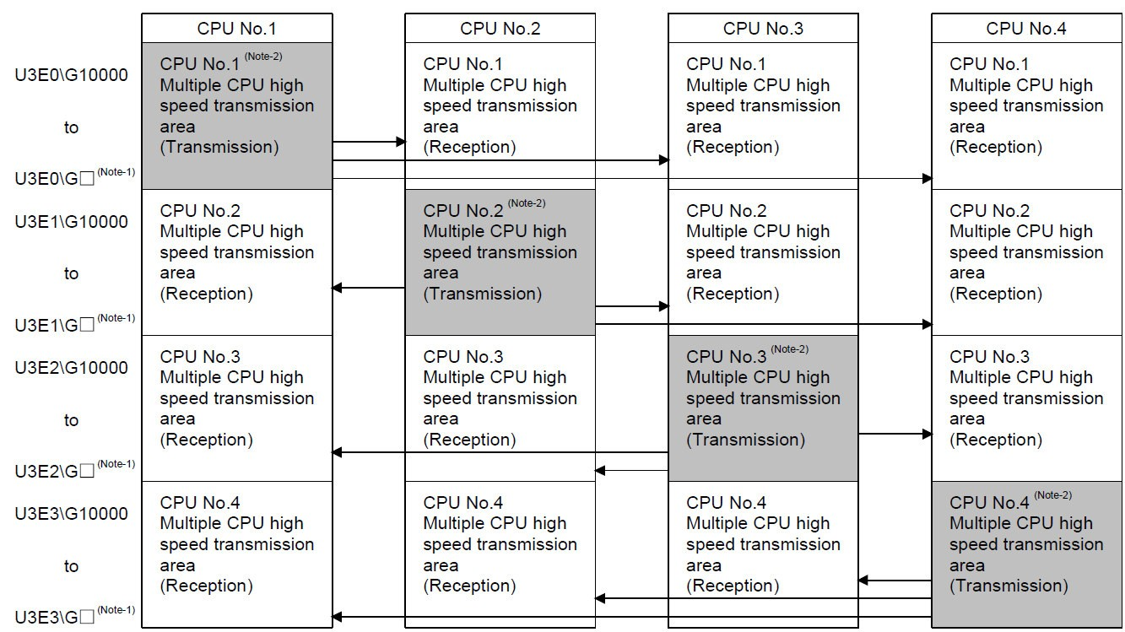
Multiple C P U High Speed Transmission Area:

Slide 25
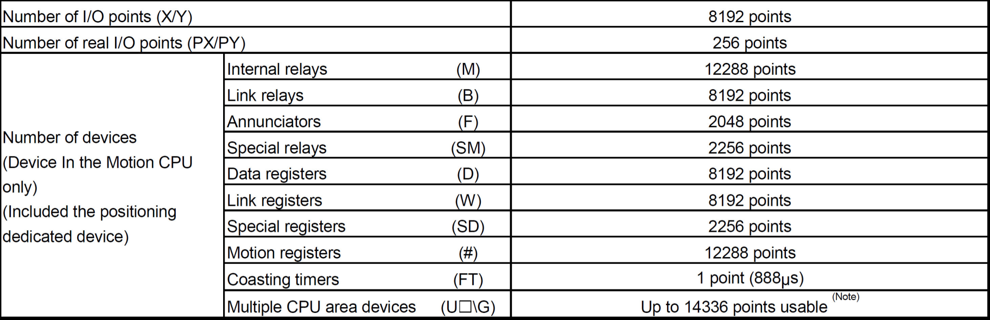
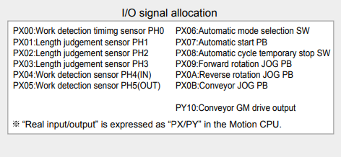
List of Devices in Motion C P U :

Slide 26
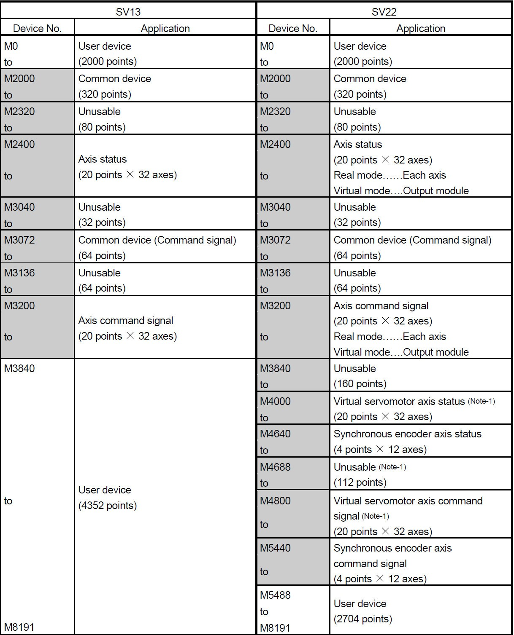
Internal Relays (M Devices) -1:

Slide 27
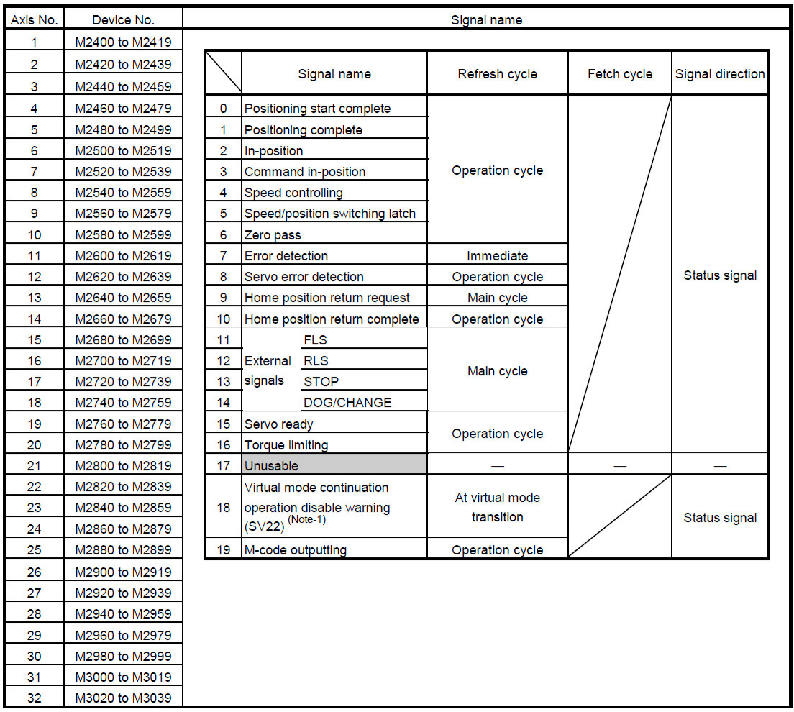
M2400 to M3039 :Real Axis Status

Slide 28
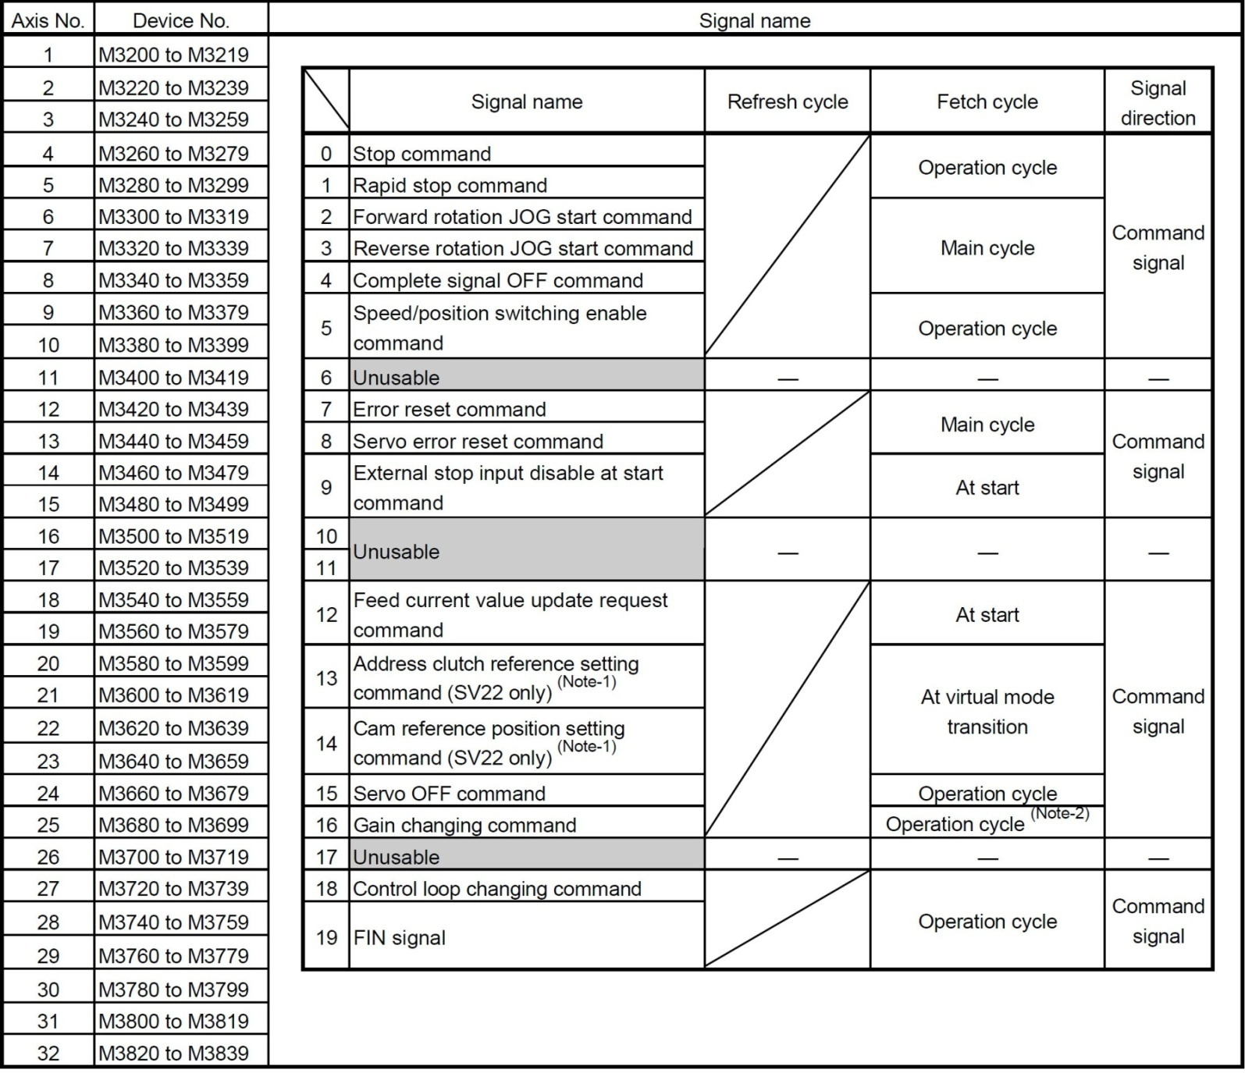
M3200 to M3839 : Real Axis Command Signal List:

Slide 29
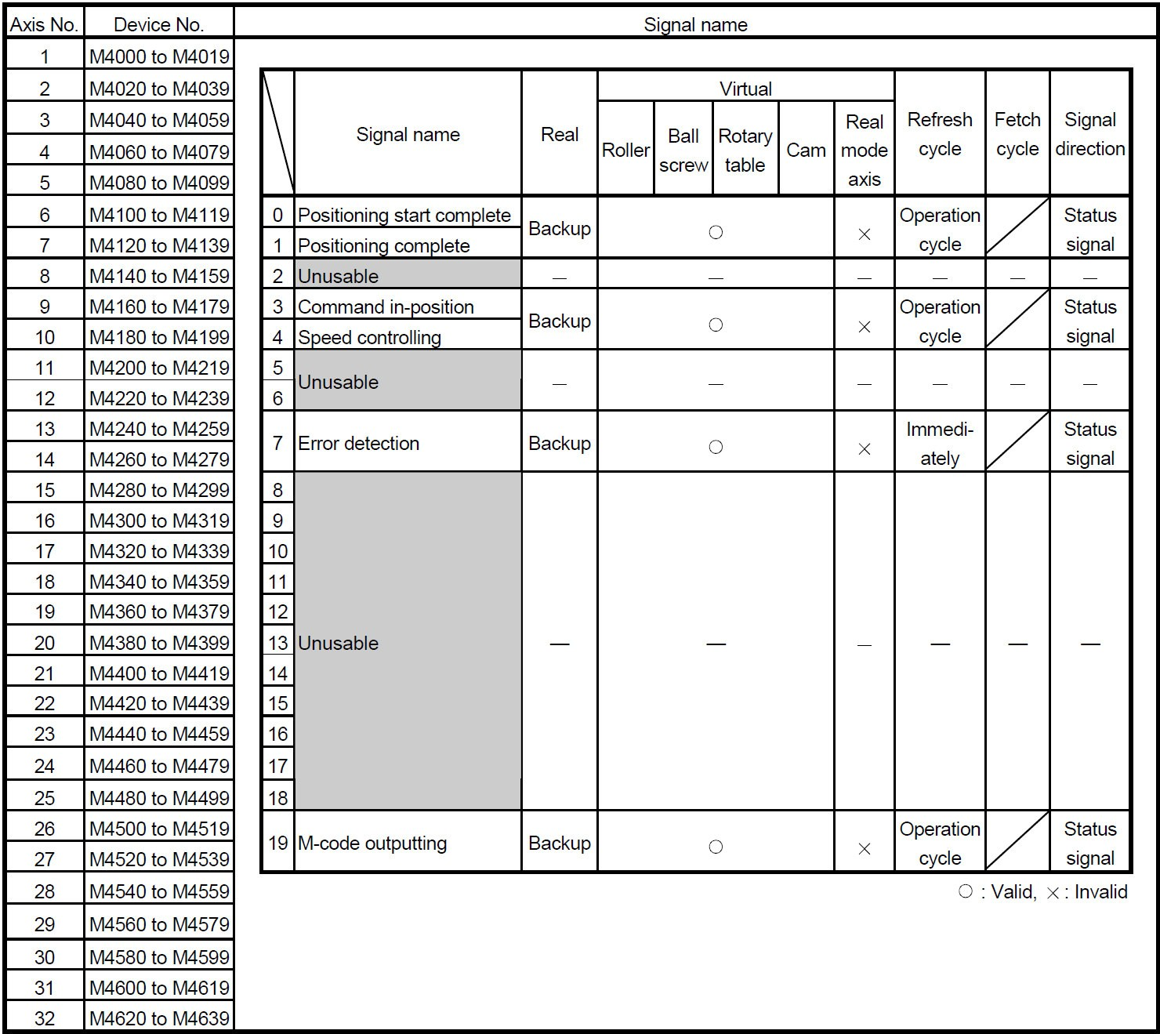
Virtual Servomotor Axis Status List:

Slide 30
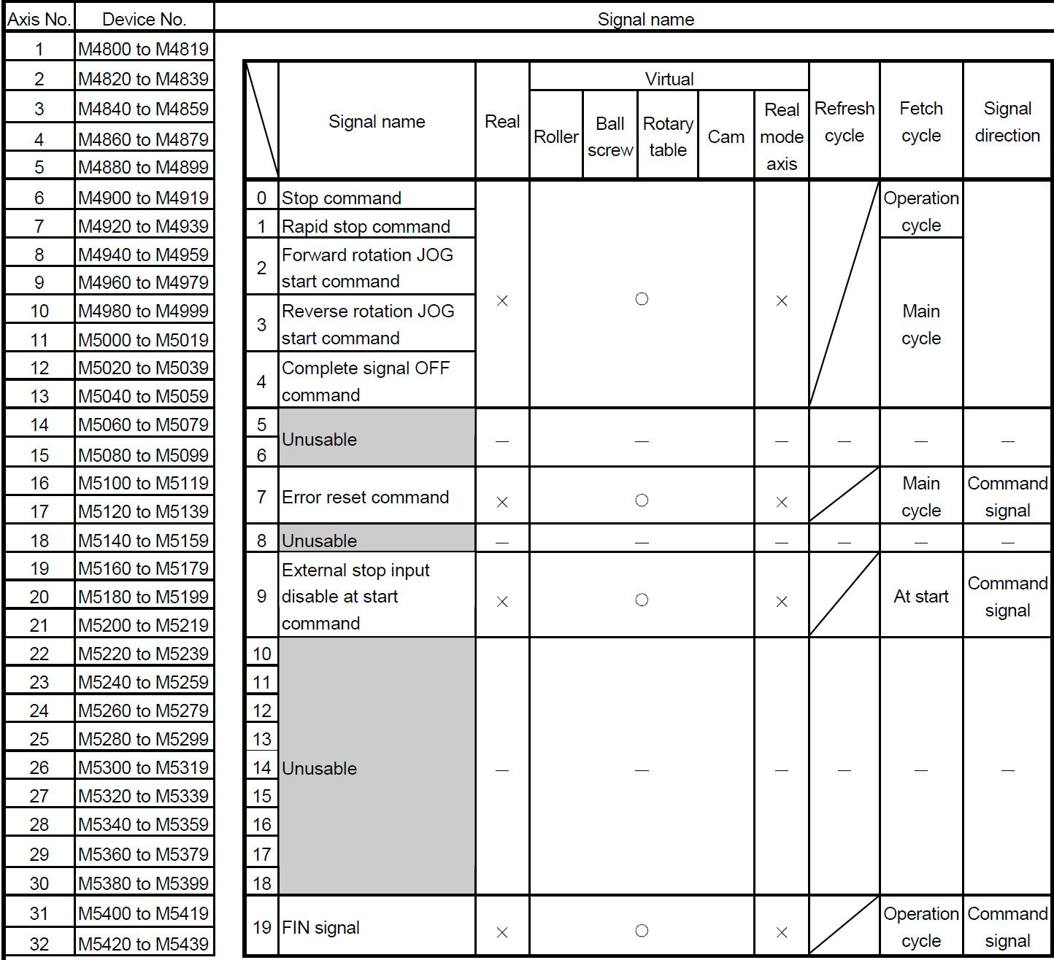
Virtual Servomotor Axis Command Signal List:

Slide 31
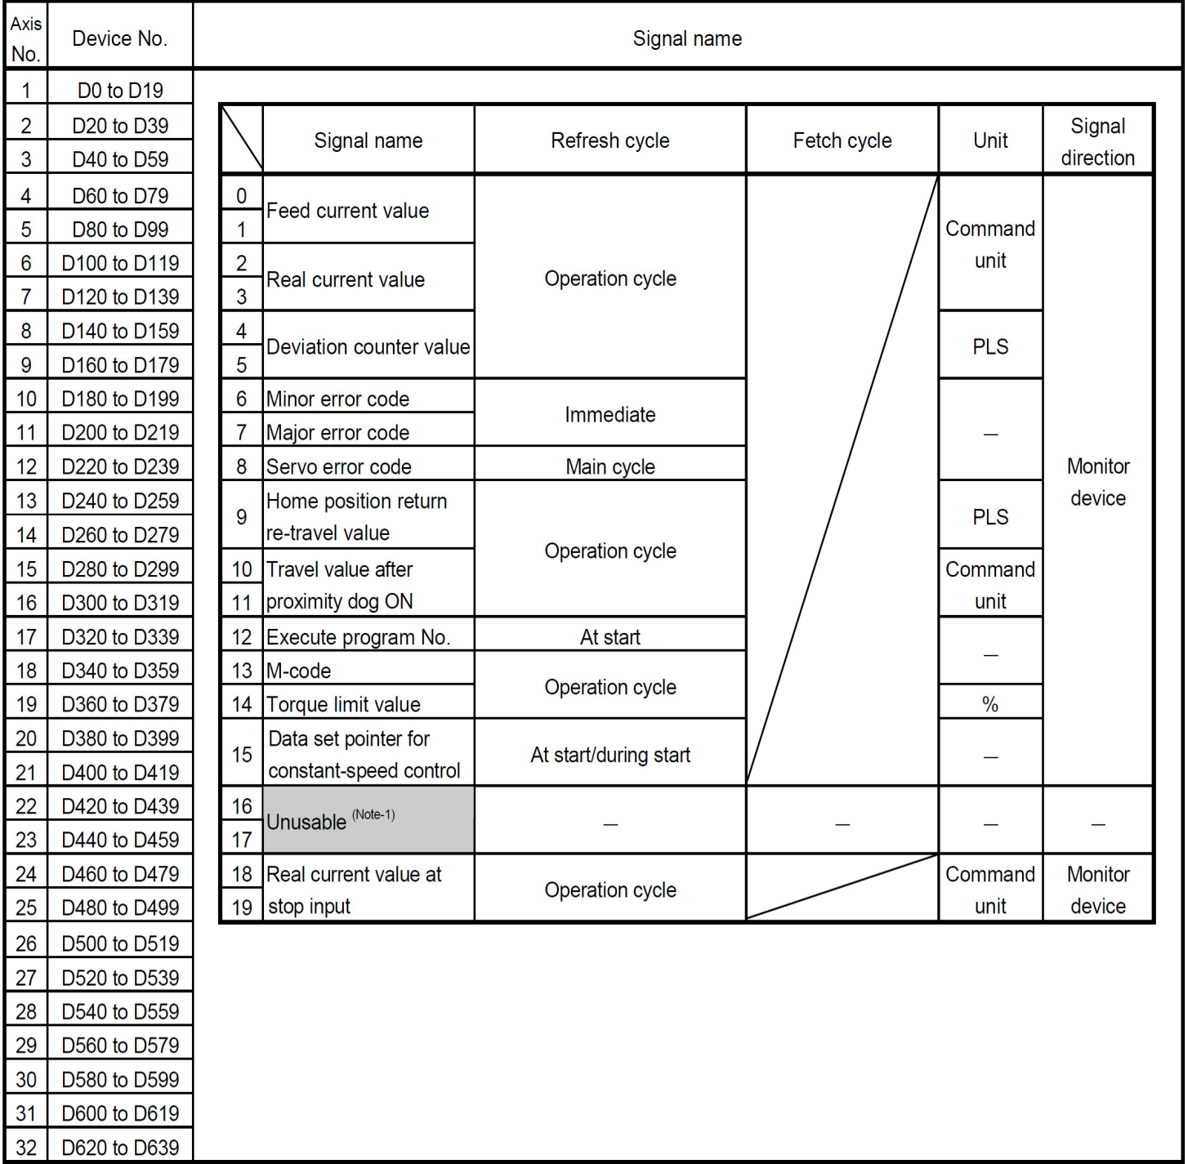
Real Axis Monitor Device List:

Slide 32
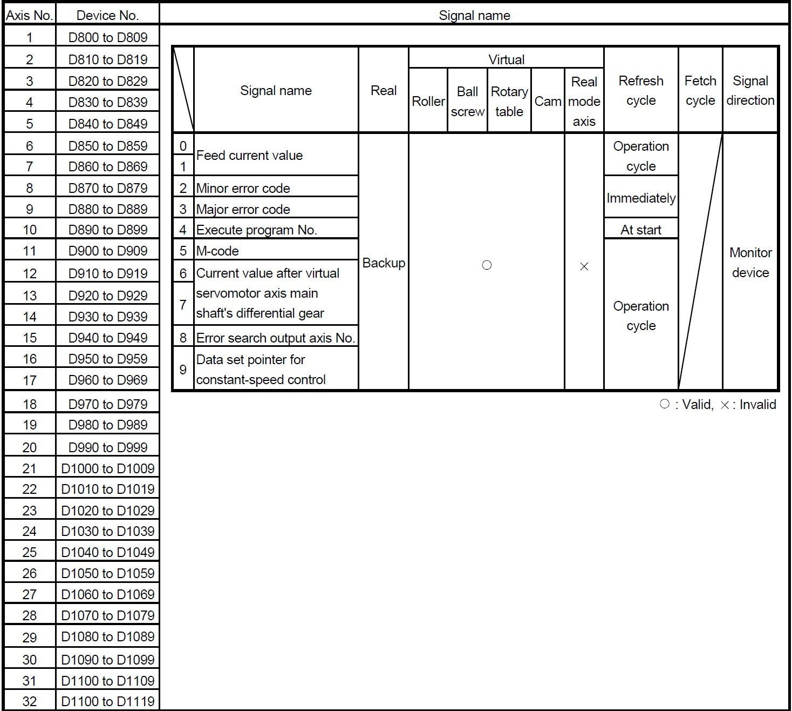
Virtual Servomotor Axis Monitor Device List:

Slide 33
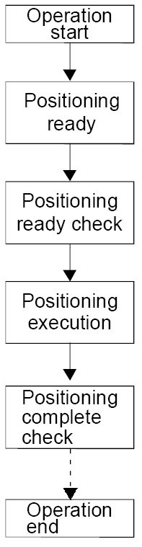
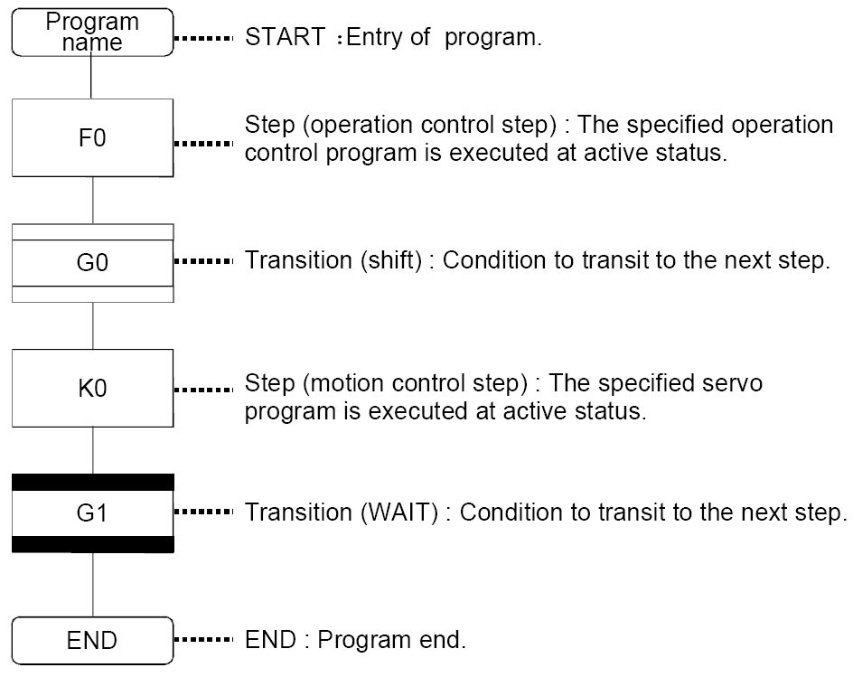
Elements of Motion S F C Program:

Slide 34
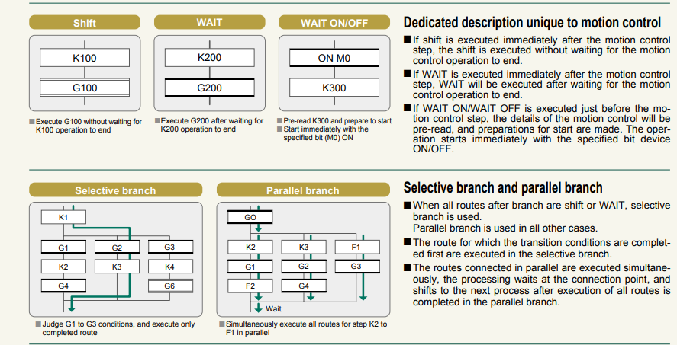
Selective and Parallel Branching:

Slide 35
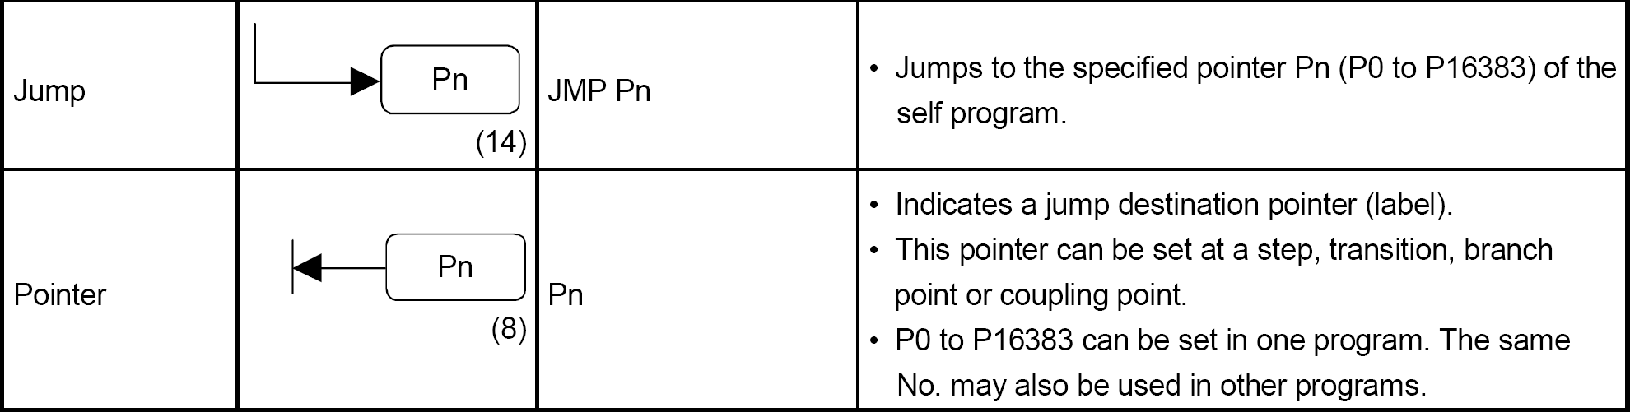
Motion S F C Symbol List (Jump and Pointer):

Slide 36
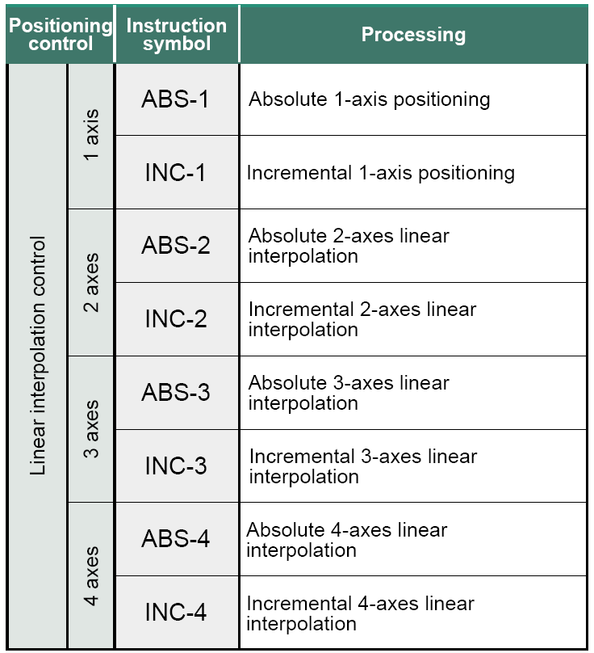
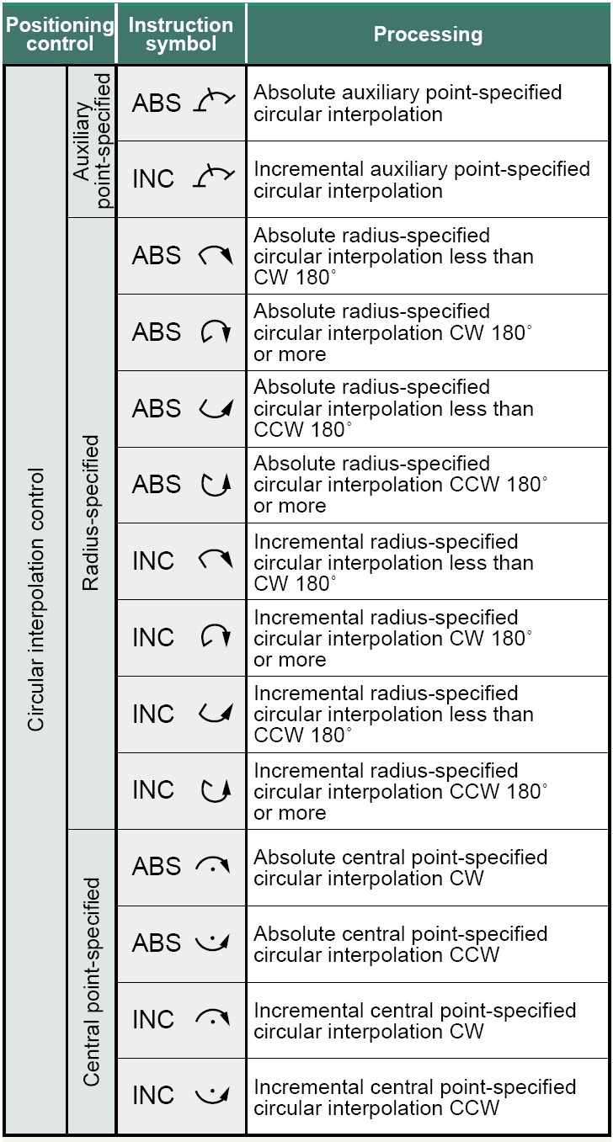
Motion Control Programs
List of the Instructions for Motion Control Programs K

Slide 37
Contents:
Bangalore Press Configuration
MT developer Software for Motion Logic

Slide 38
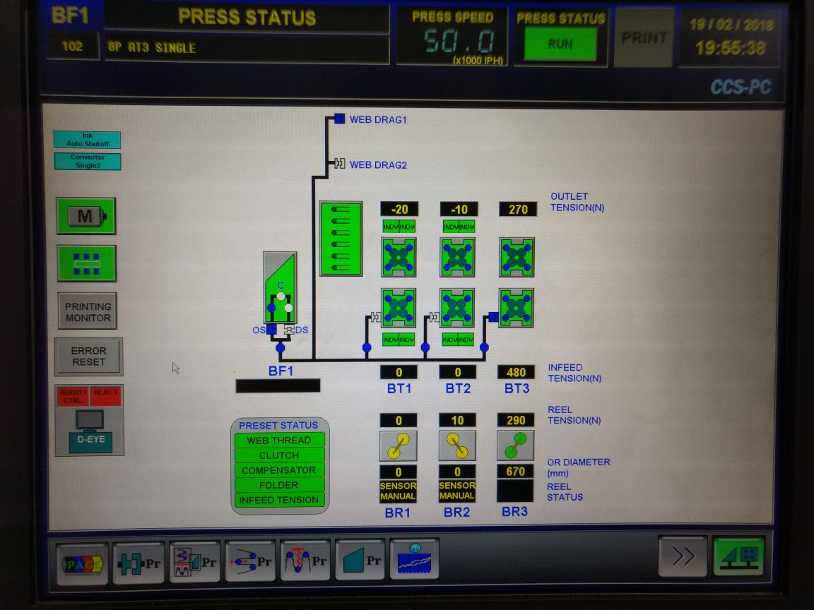
Bangalore Press Configuration:

Slide 39
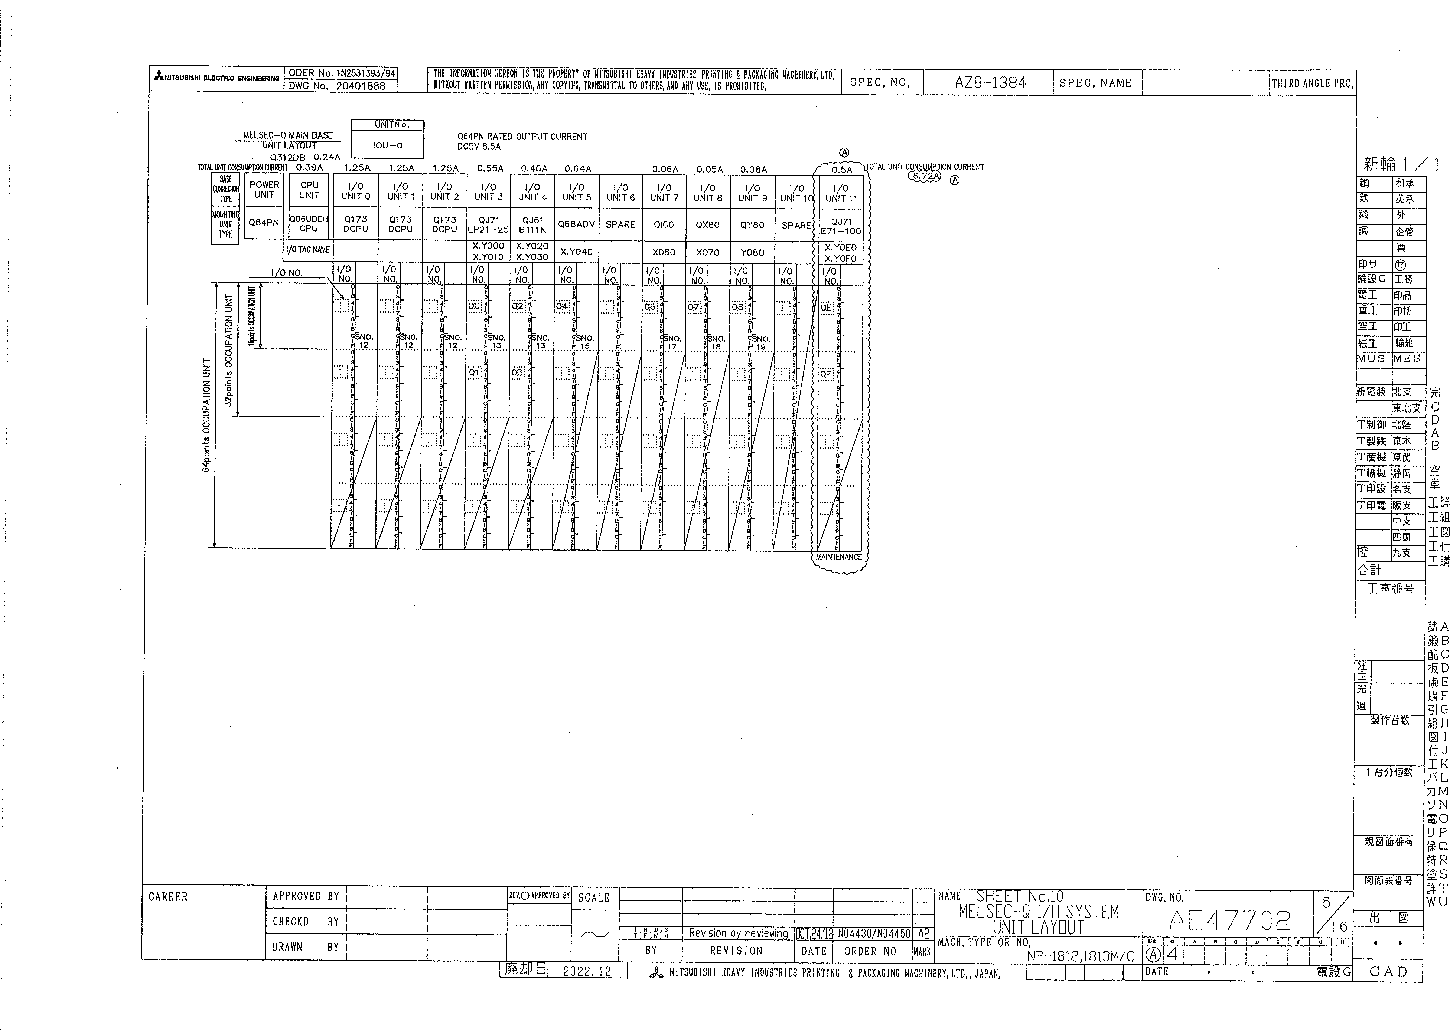

Slide 40
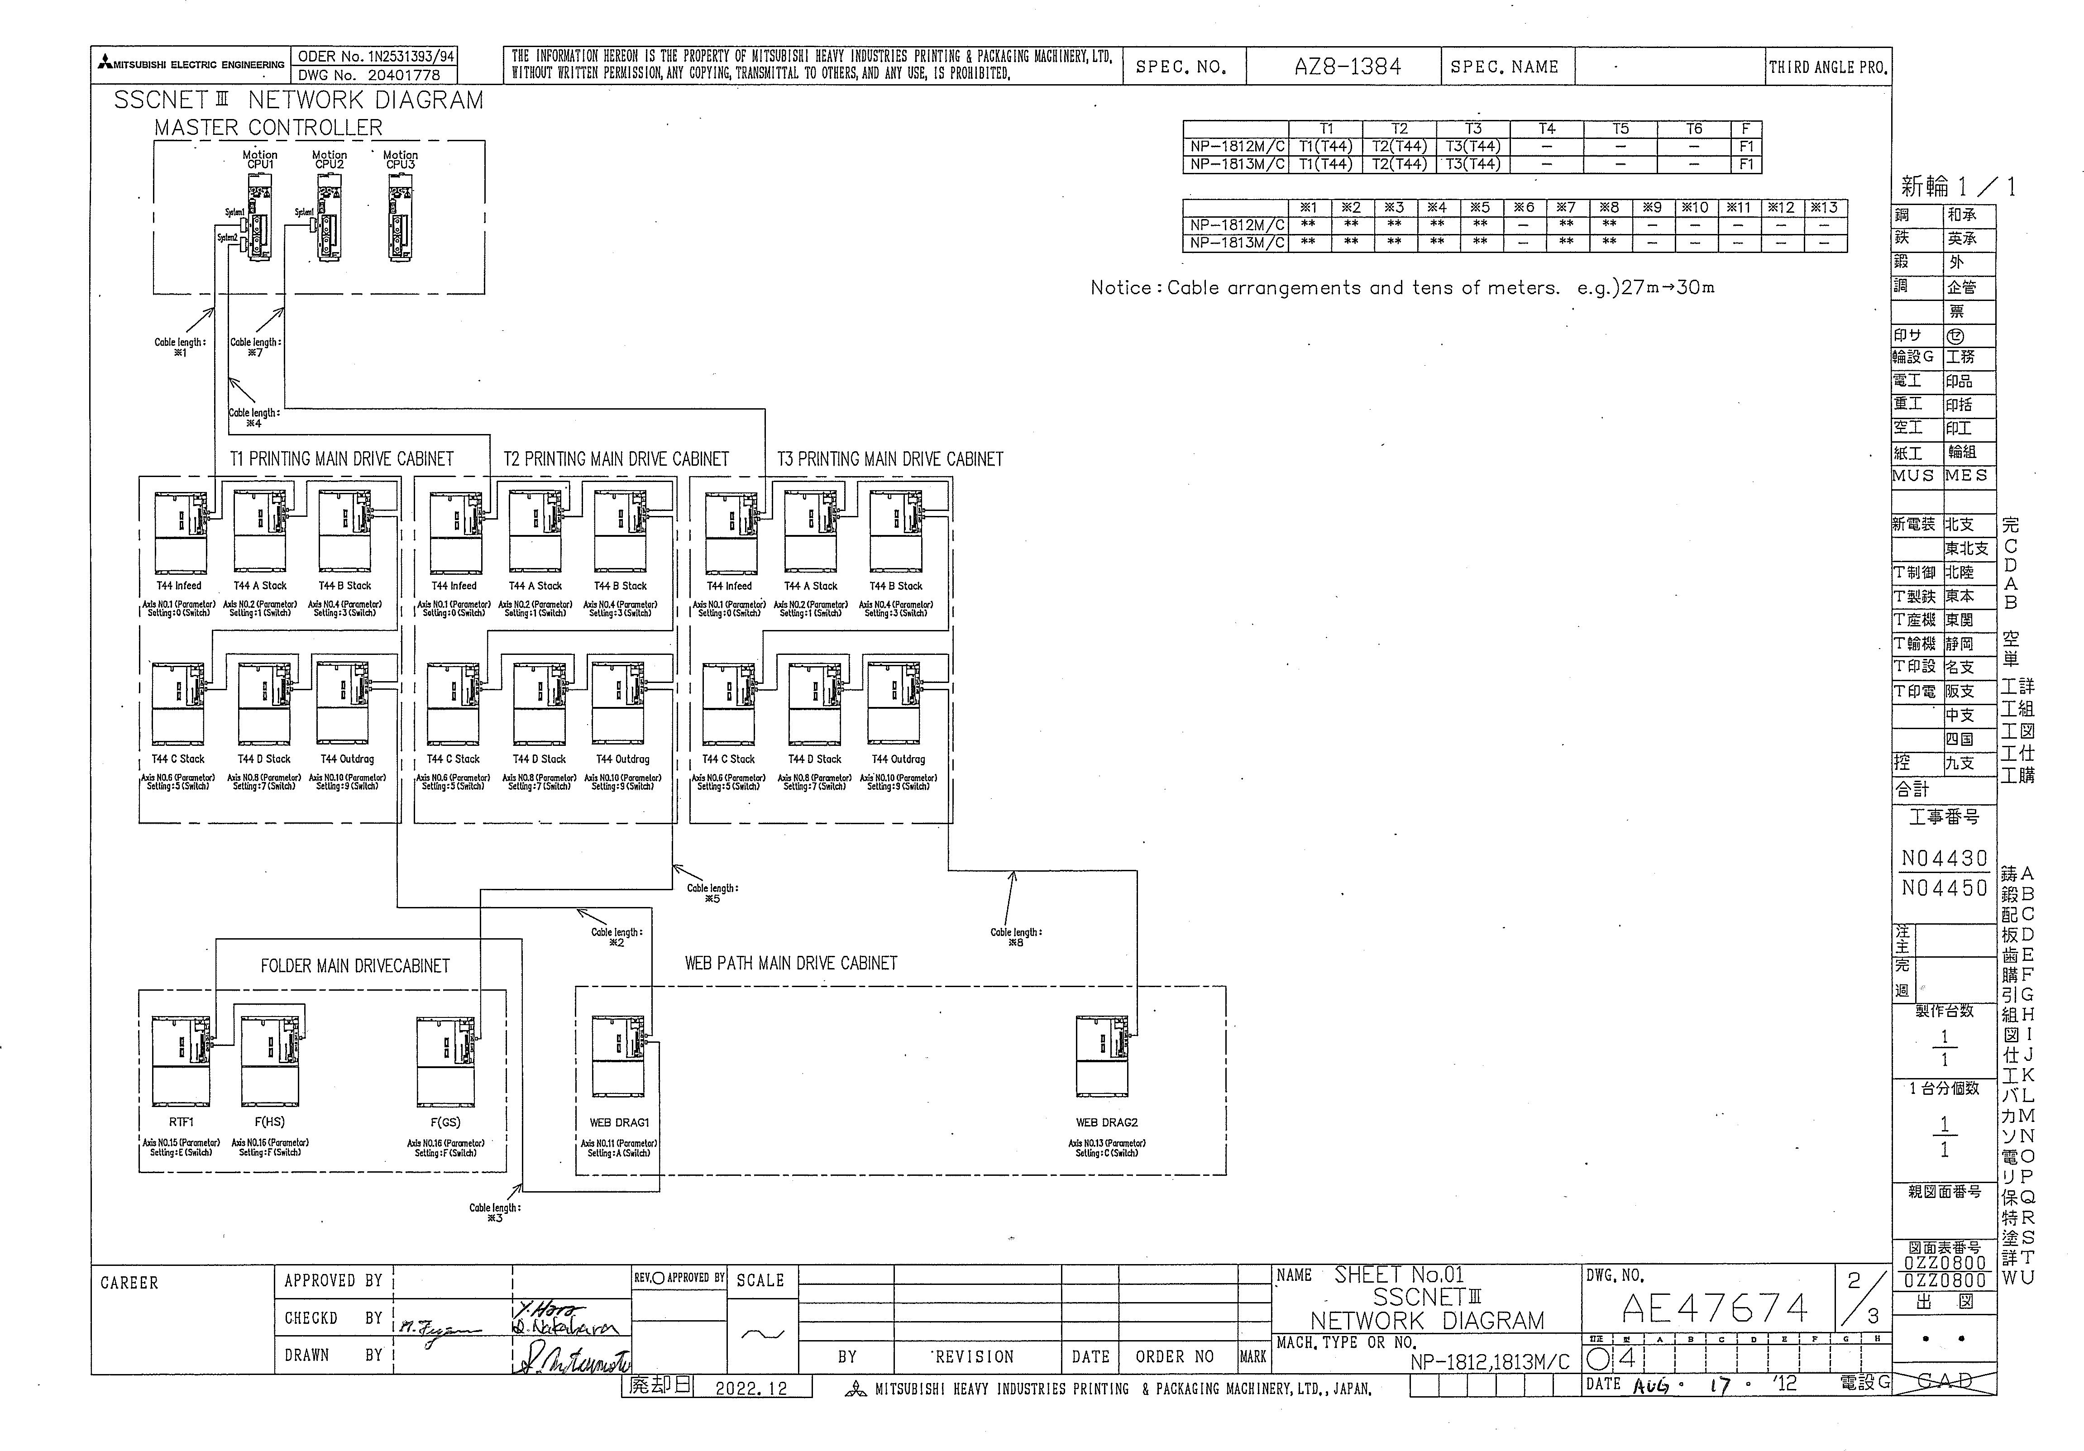

Slide 41
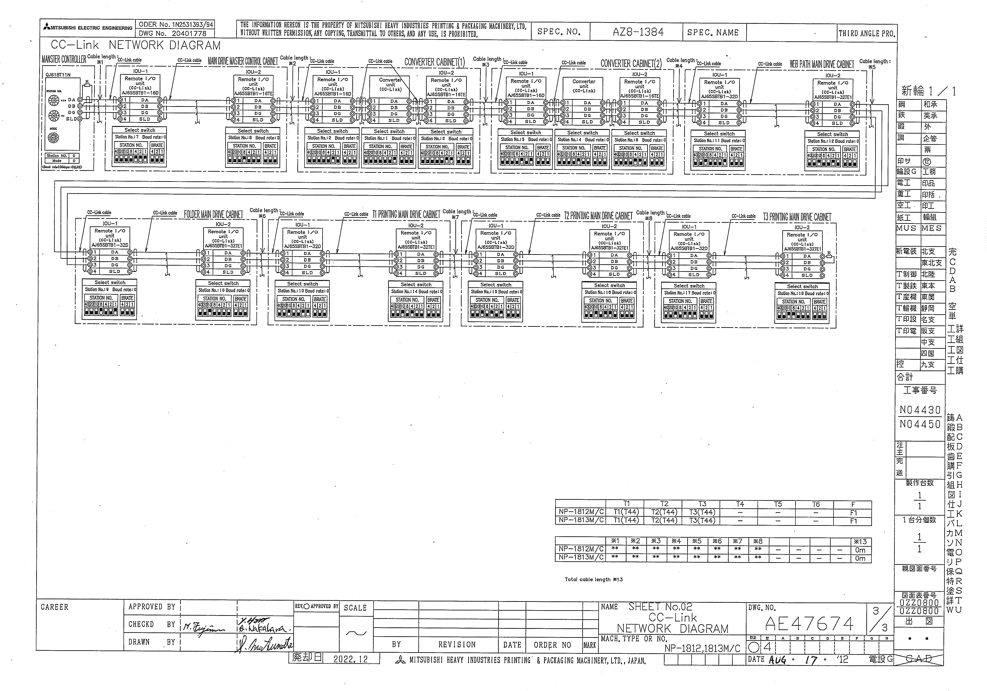

Slide 42
MT developer Software for Motion Logic Control

Slide 43
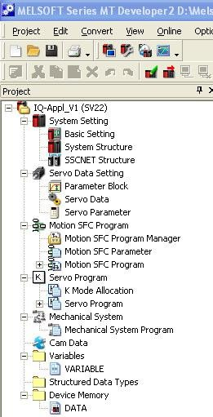
Project Navigator:
Each operation of tools, which used to be started individually, are integrated in one application and can be executed from the project window.

Slide 44
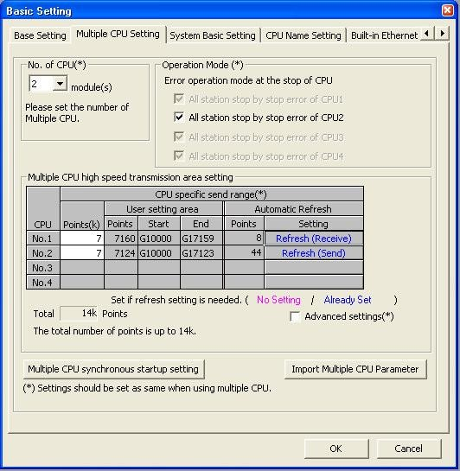
Basic Setting : Multiple C P U Setting
8-Sep-12
11

Slide 45
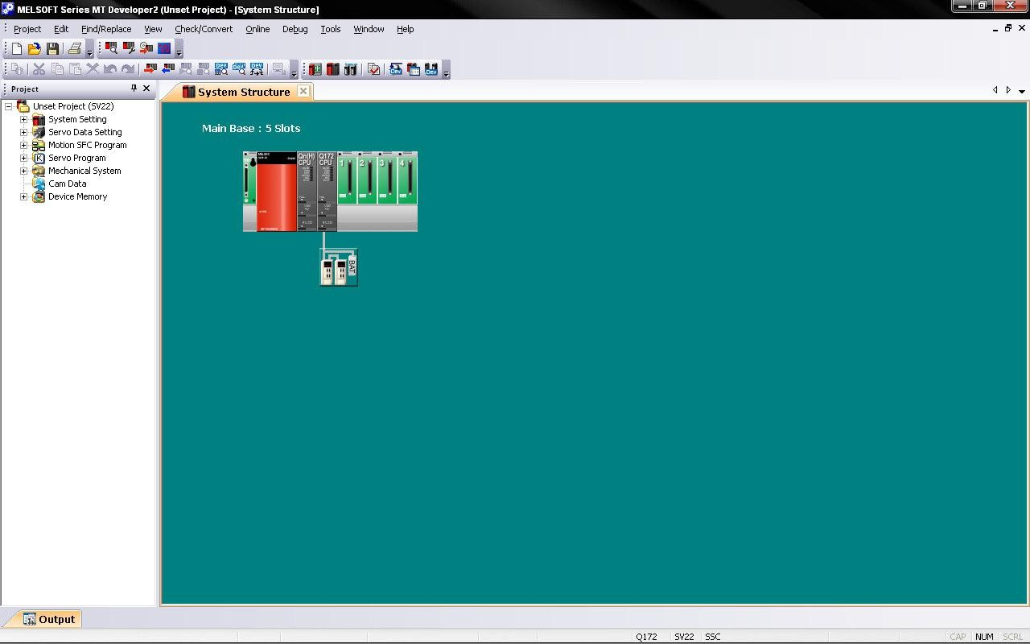
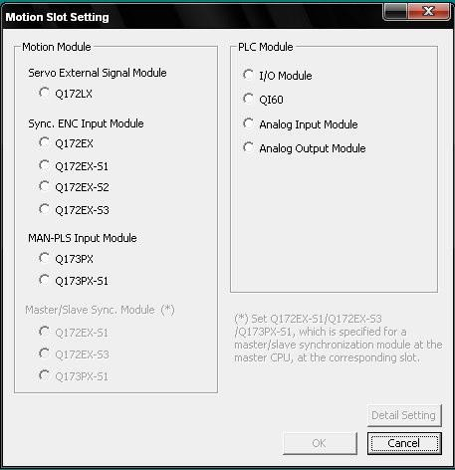
System Structure:
8-Sep-12
13

Slide 46
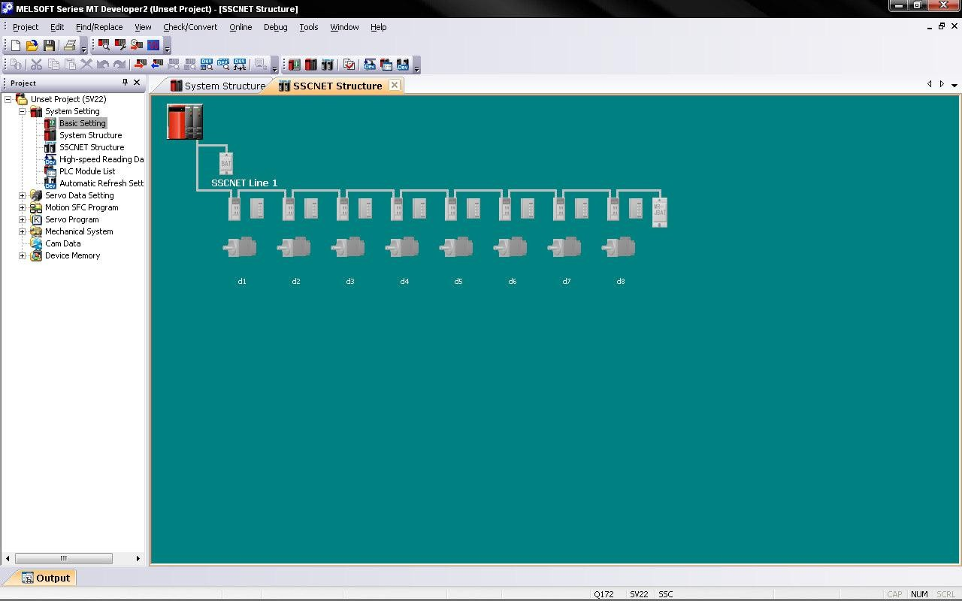
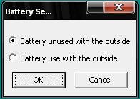
S SC N E T Structure:
8-Sep-12
14

Slide 47
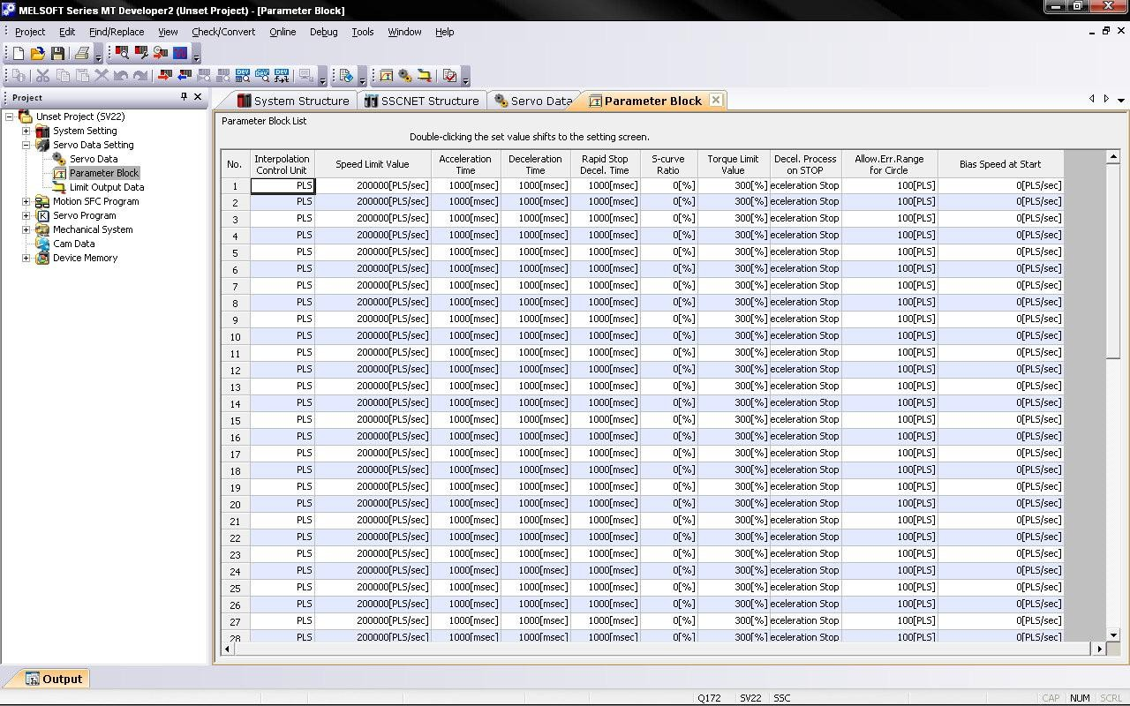
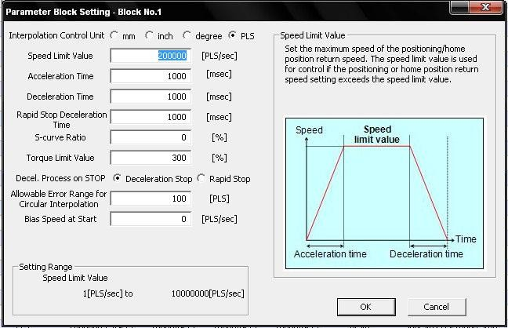
Parameter Block:
8-Sep-12
17

Slide 48
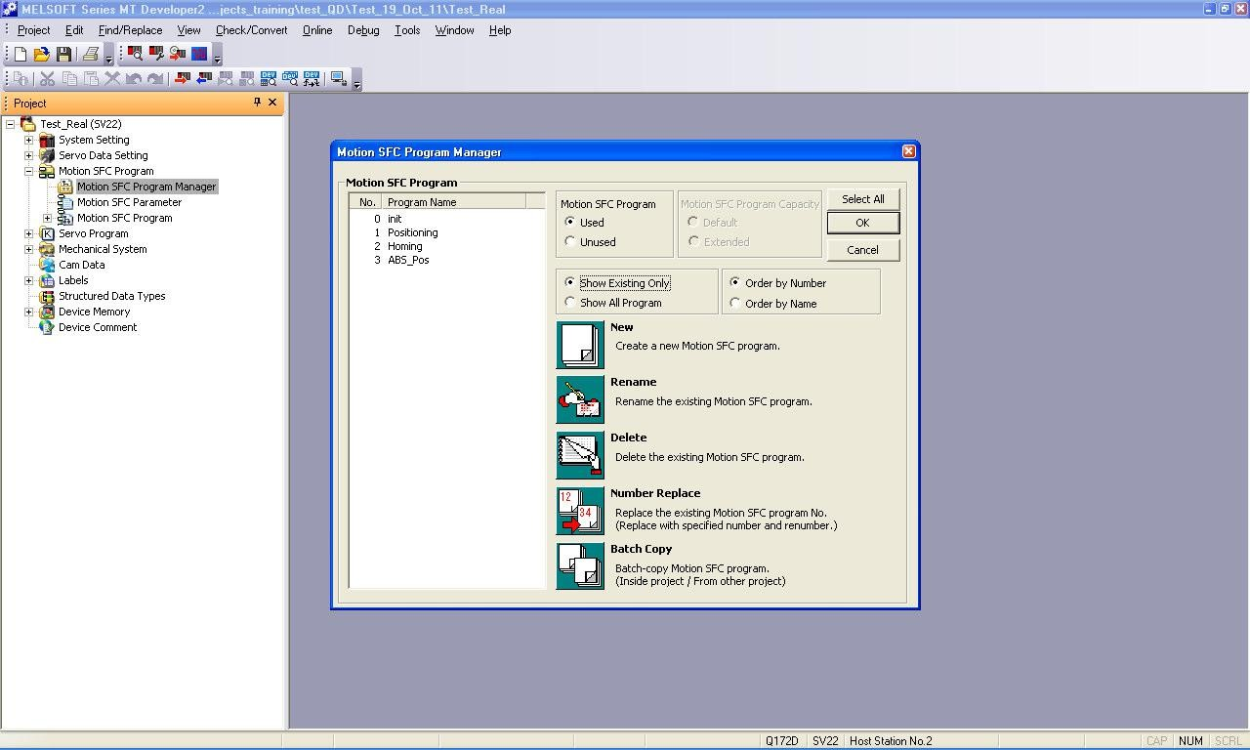
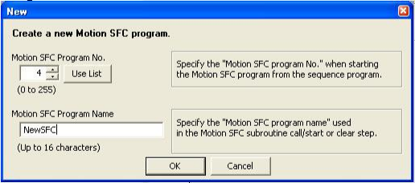
S F C Program Editor:

Slide 49
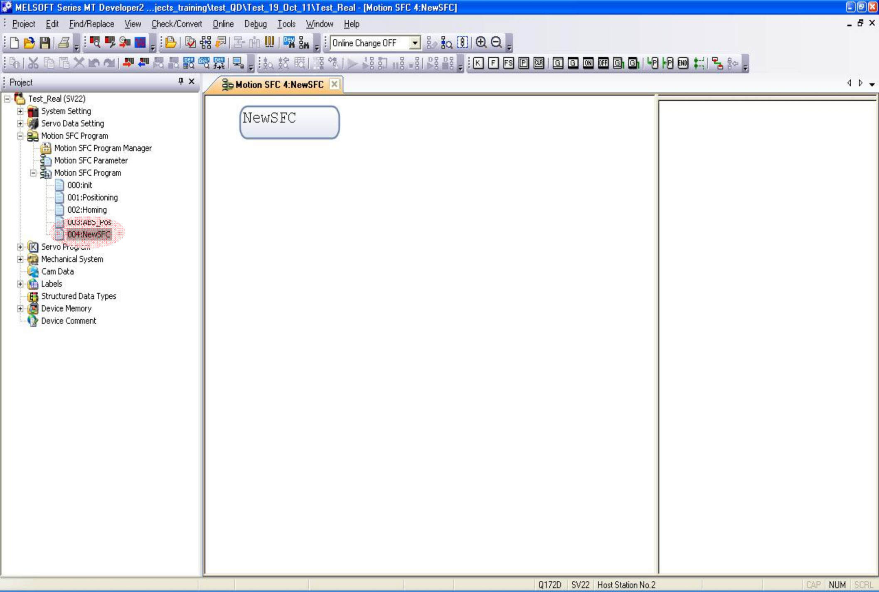
S F C Program Editor:
Starting Step comes with the SFC Program Name automatically

Slide 50
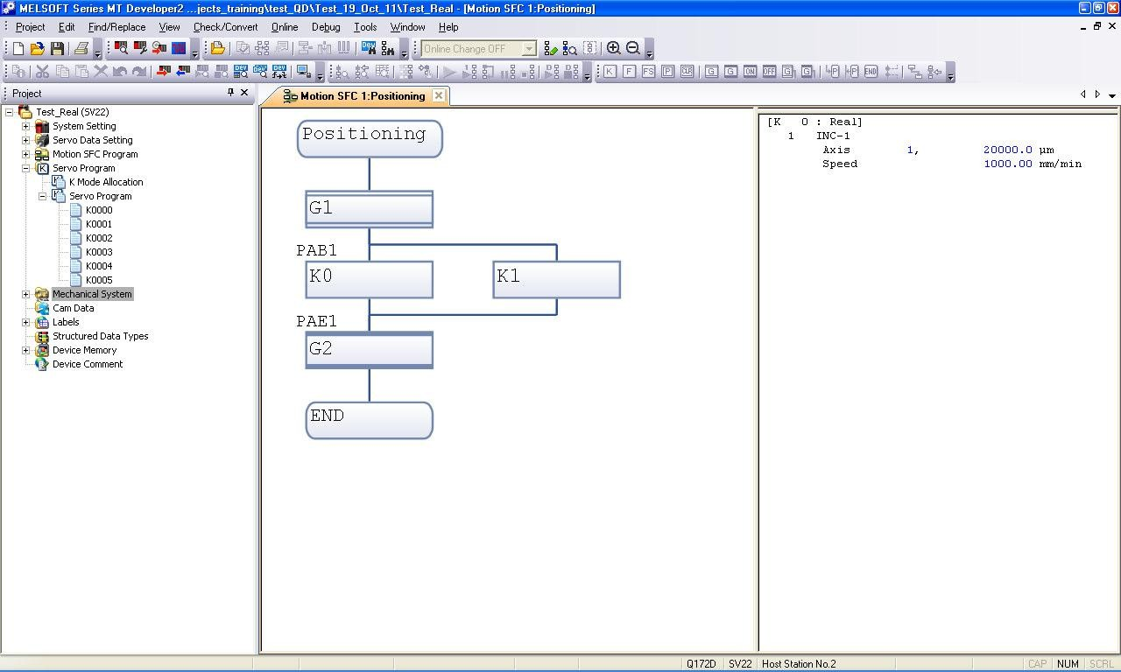
Motion S F C : Sample Program:

Slide 51
Mechanical System Program:
Mechanical System Editor (Program) is only used in SV22 (Virtual Mode)
Components
Virtual Servo Motor & Auxiliary Virtual Servo Motor
Synchronous Encoder
Different types of Gears
Clutches
Output Axis like CAM, Rotary Table, Roller and Ball Screw

Slide 52

Mechanical System Program:
Toolbar for Mechanical System Design
Pick & Place Components from Toolbar
Create new page (Double Click on Mech. Sys. Prog.
and select page no.)
For Q172 CPU, 8 pages and for Q173 CPU, 32 pages can be created

Slide 53

Mechanical System Program : Sample

Slide 54

S S C N E T III Monitor:
State of SSCNET III Network including state information of amplifiers.

Slide 55
MMN Nagar Press Configuration with Motion Logic Controller

Slide 56
MMNagar Configuration:
Total drives in T44 cabinet-8(for 3 towers=24)
Total drives in T11 cabinet-6
Total drives in Webpath cabinet-9
Total drives in Folder cabinet-4
Total drives in Balloon former cabinet-3
Total drives=46 drives required.

Slide 57
Motion Logic Configuration:(1st possibility)
PLC Rack Configuration
1.Q06UDEH CPU(sequential CPU)
2.Q173D- 32 axis
AT1,AT2,AT3/AT4 and AT5 -30 drives (Cycle time 1.77ms)
3.Q173D-32 axis
Webpath,Folder,Ballon-16 drives (cycle time 0.88ms)
4.QJ71LP21-25(For Communicating with Unit CPU)
5.QJ61BT11N(For external inputs and outputs)
Drives to be Used for is- MR-J3 type
Motor to be Used is- HA series servo Motor (5kW to 55kW available)
Communication-SSCNET III

Slide 58

Motion CPU 1:

Slide 59

Motion CPU 2:

Slide 60
Q17nCPU Technical Data:
Feature |  | Q172DCPU | Q173DCPU
Axes |  | 8 | 32
Cycle time | SV13 | 0.44 ms / 1 to 6 axes 0.88 ms / 7 to 8 axes | 0.44 ms / 1 to 6 axes 0.88 ms / 7 to 18 axes 1.77 ms / 19 to 32 axes
 | SV22 | 0.44 ms / 1 to 4 axes 0.88 ms / 5 to 8 axes | 0.44 ms / 1 to 4 axes 0.88 ms / 5 to 12 axes 1.77 ms / 13 to 28 axes 3.55 ms / 29 to 32 axes
Interpolation |  | Up to 4 axes linear interpolated, 2 axes circular interpolated Helical Interpolation for 3 axes
Positioning |  | PTP (Point-to-Point), Speed-/Position control mode, Fixed Speed, Constant Speed, Speed Changing Function, Synchronisation (SV22)
Acceleration / Deceleration |  | Automatic trapezoidal Acceleration /Deceleration; S-curve Acceleration / Deceleration
Compensation functions |  | Backlash compensation, electronic gear

Slide 61
Motion Logic Configuration:(2nd possibility)
PLC Rack Configuration
1.Q06UDEH CPU(sequential CPU)
2.Q173D- 32 axis
AT1 and AT2 -16 drives (Cycle time 0.88ms)
3.Q173D-32 axis
Webpath,Folder,Ballon-16 drives (Cycle time 0.88ms)
4.Q173D-32 axis
AT3/AT4 and AT5- 14 drives (Cycle time 0.88ms)
5.QJ71LP21-25(For Communicating with Unit CPU)
6.QJ61BT11N(For external inputs and outputs)
Drives to be Used for is- MR-J3 type
Motor to be Used is- HA series servo Motor (5kW to 55kW available)
Communication-SSCNET III
Advantage: Cycle time of the CPU is decreased.

Slide 62
Thank You

